Slide 1

CCPS 506
Comparative Programming Languages
Fall 2019
Lecture 8: Actions in Haskell, Rust intro

Slide 2

Course Administration
Getting closer! Four more weeks.
Don’t forget about the assignments!

Slide 3


Slide 4
Let’s Get Started!

Slide 5
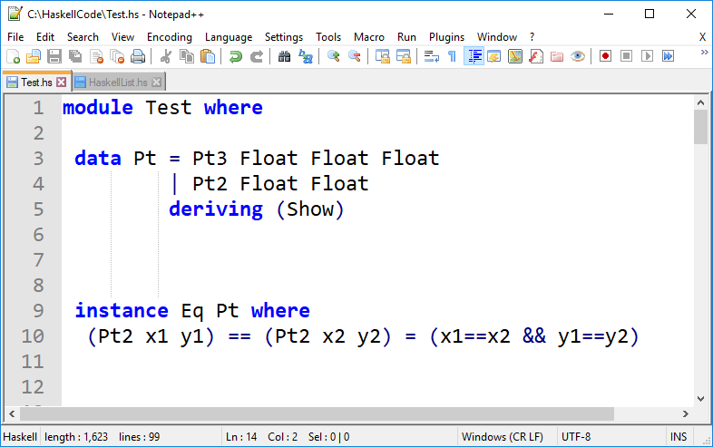
Last Week
Define what it means for two Pt2 variables to be considered equal
Declare Pt to be an instance of Eq

Slide 6
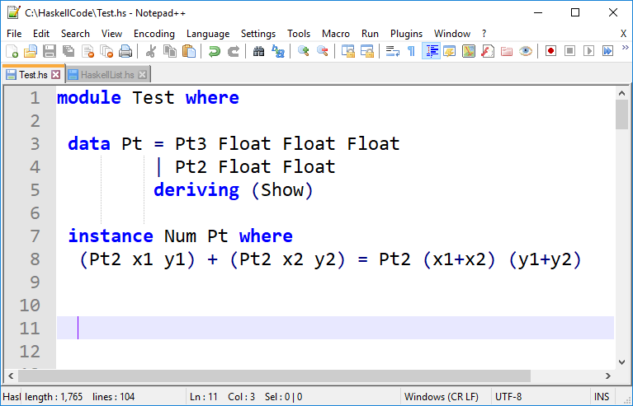
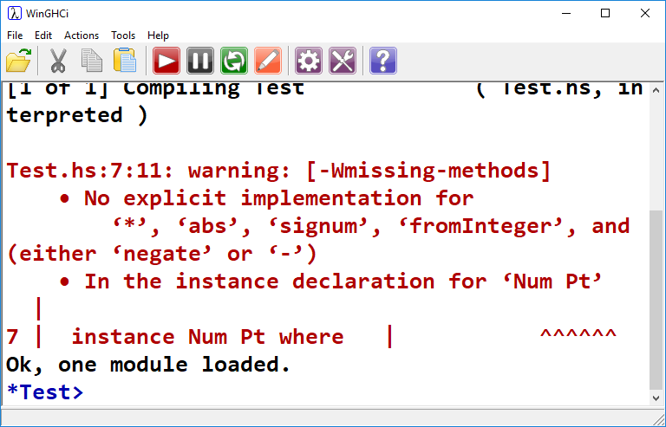
Last Week

Slide 7
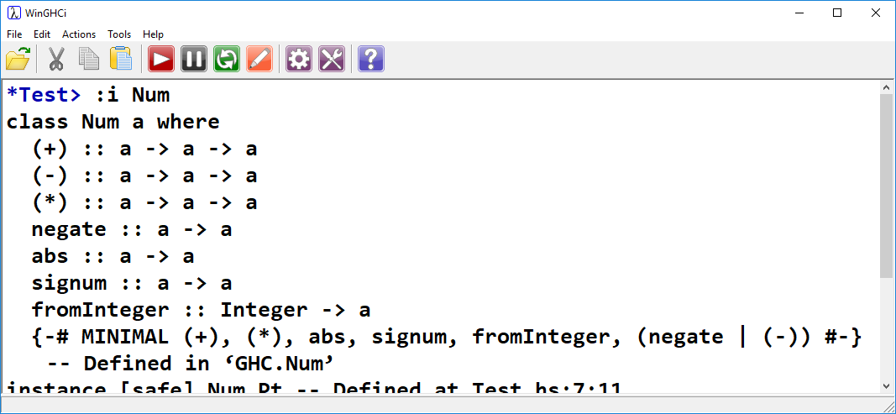
Last Week

Slide 8
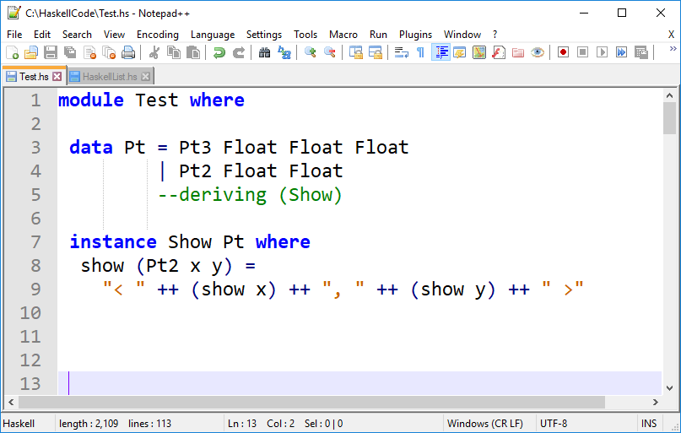
Last Week
No longer need to derive Show, we’ve made our own
Use string concatenation to create a pleasing visual output for Pt2.
In doing so, we make use of show as defined for Floats

Slide 9
Pure Code, Monads, Actions

Slide 10

Every function is pure
Pure Functions: Functions that have no side effects.
A function can be said to have a side effect if it has an observable interaction with the outside world aside from returning a value.
Modify global variable
Raise an exception
Write data to display or file

Slide 11
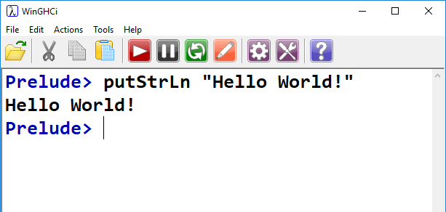
Write to Display
This was the very first thing we saw!

Slide 12
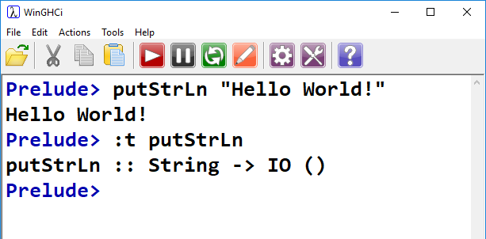
Haskell and I/O
Haskell separates pure functions from computations where side effects must be considered
Encodes side effect-producing functions with a specific type.
We’ve already seen an example of this:

Slide 13
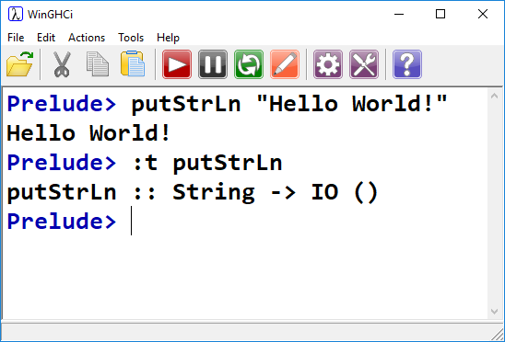
Haskell and I/O
Printing to the screen and reading from a file are not considered functions.
Rather, they are actions.
Actions also have a special type
putStrLn accepts a String argument.
What it returns is an action of type IO()

Slide 14
Haskell and I/O
Speaking precisely:
putStrLn is a function (no side effects!)
Takes a String as an input argument
Returns an action, whose type is IO()
When the IO() action is executed, it returns ().
This can be read as an empty tuple. It is similar to null in Java or C.
The action (when executed) produces a side effect.
The putStrLn function, strictly speaking, does not.

Slide 15
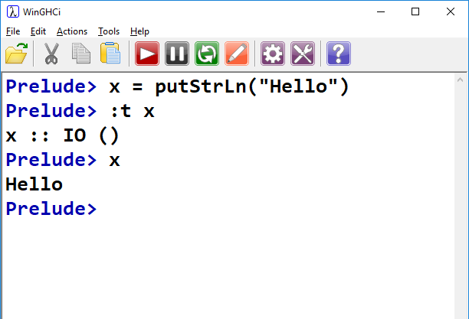
Haskell and I/O
Execute the action
Actions are values, just like functions, strings and numbers.
They are completely inert – they do not affect the outside world until executed.

Slide 16
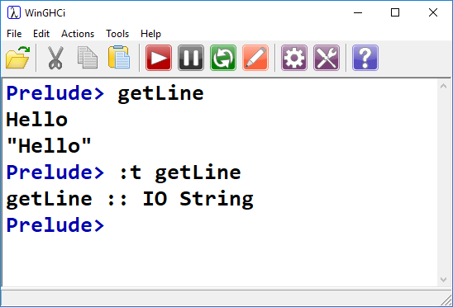
Haskell and I/O
We can also look at getLine
getLine accepts an IO action as input
The IO action returns a String
IO String vs IO ()
Within getLine, the action will be executed.
Ordinary Haskell evaluation doesn’t cause actions to be executed.
GHCi will execute actions for us, as seen previously.

Slide 17
Just remember: actions are not functions.
Functions are pure. Actions (specifically IO actions), when executed are not.
Functions are evaluated, actions are executed
Actions are values. Actions can be returned by functions, or passed as arguments.
Actions have a type. We’ve seen one so far, IO

Slide 18
Actions can only be executed from within other actions.
A compiled Haskell program begins by executing a single action – main::IO()

Slide 19
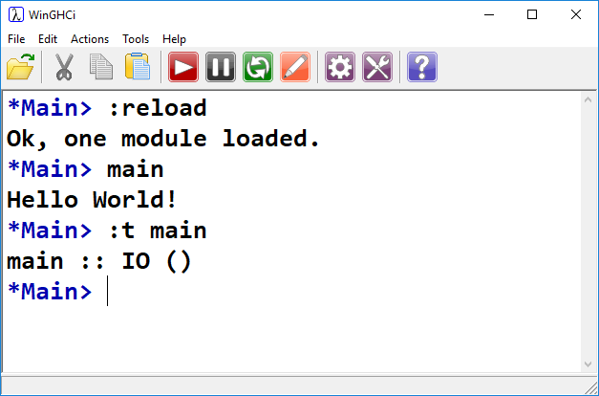
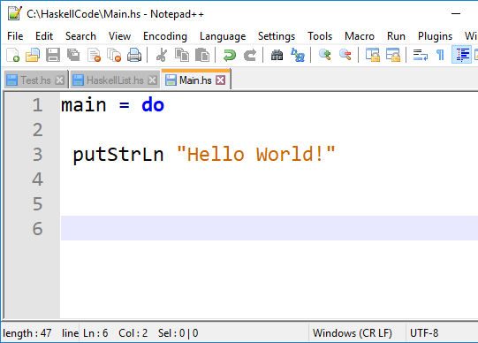
main::IO()
Recall: Every compiled Haskell program must have a main function:
The main function is a single action
This action is executed when the program is run.
A Haskell program, by itself, is a single action that is executed when we run the program.

Slide 20
Staying Grounded
A Haskell program begins with the execution of a single action (main::IO())
Functions that return actions are often incorrectly referred to as actions.
From within this action, any additional number of actions can be executed
Pure functions can also be evaluated from within actions!
However – actions cannot be executed from within pure functions.
If we try, Haskell will infer the type of the no-longer-pure function as an action.

Slide 21
Staying Grounded
An action can be thought of as a recipe
This recipe (in the case of IO) is a list of instructions that would produce side effects.
The act of creating this recipe does not have side effects.
The recipe can be the output of a pure function.
Same inputs to the function, same recipe.

Slide 22
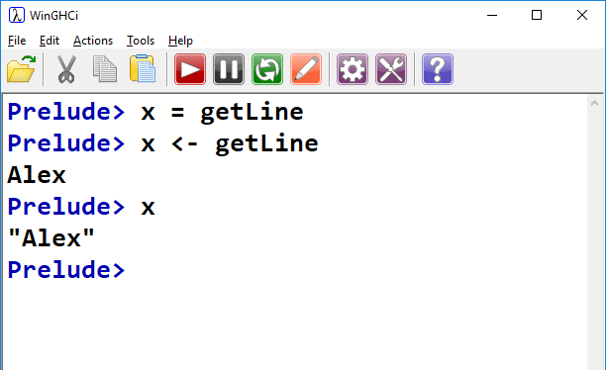
IO Actions
We can use the <- operator to execute:
The <- operator is used to pull out the result from executing an IO action.
We can then bind a variable to it.
The return value of getLine (String) is the result of executing an action.

Slide 23
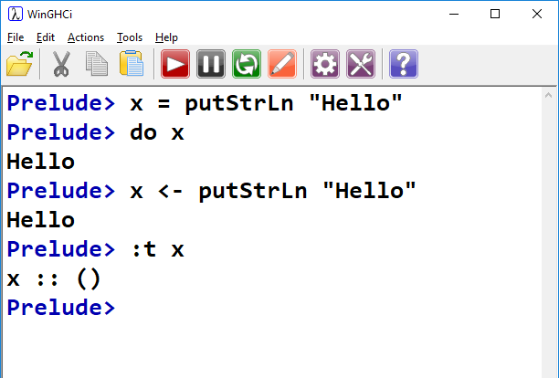
IO Actions

Slide 24
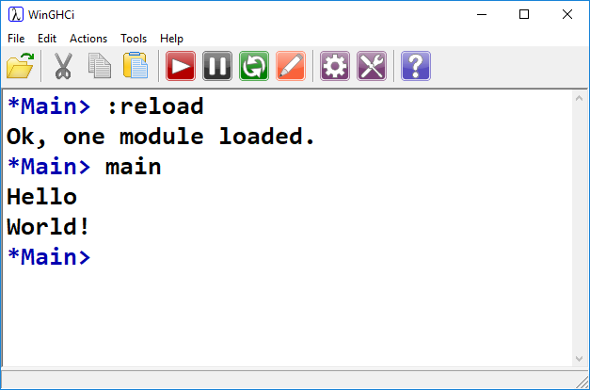
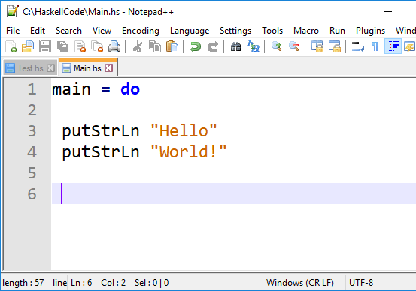
Combining Actions
We can do this using the do keyword:
When using the do keyword, we can execute one action per line.

Slide 25
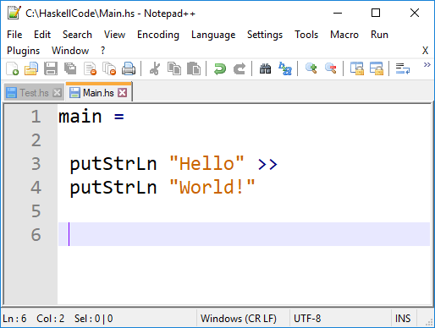
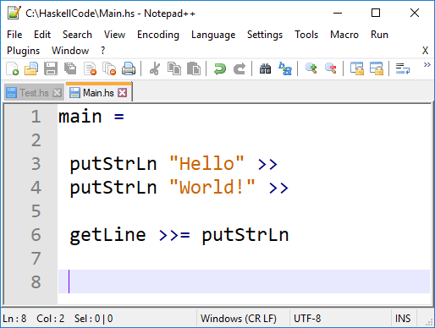
Combining Actions
do is syntactic sugar for >>
>> says execute this, then this.
If the first action produces a result, it is discarded.
What if we want to use the result?
Use the >>= operator to pipe the result into the next action.
Here, we grab a string using getLine, and display it using putStrLn
getLine returns a string, putStrLn takes a string as an argument.

Slide 26
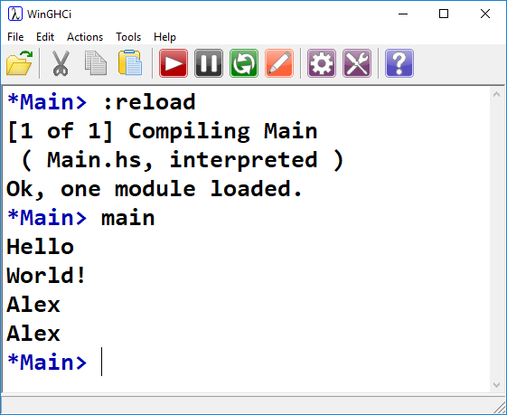

Slide 27
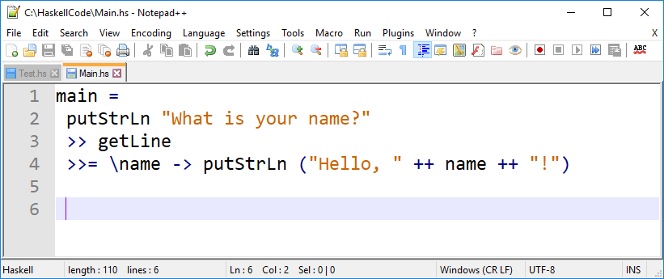
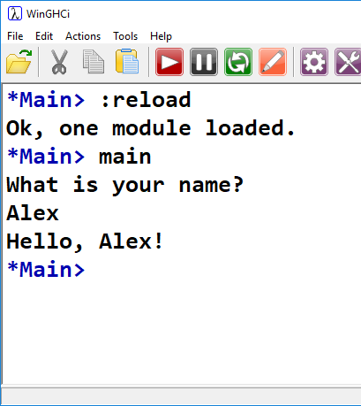
More Complicated
Lambda function accepting 1 arg, name
Received directly from the getLine above

Slide 28
Up until now, we’ve only really seen how to evaluate expressions (and execute actions, though we didn’t know that’s what we were doing) in GHCi.
Now we’re seeing how to write, compile, and execute a complete Haskell program containing actions.

Slide 29
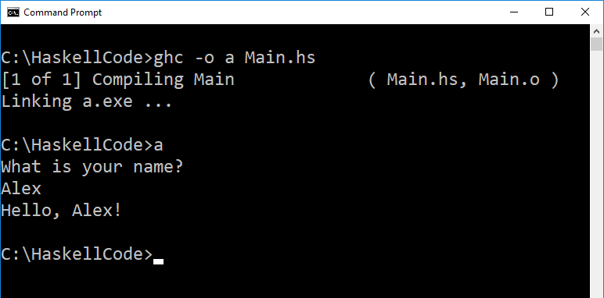

Slide 30
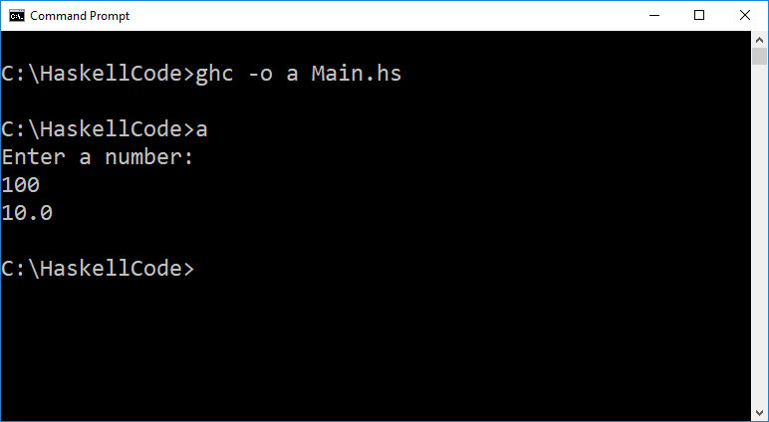
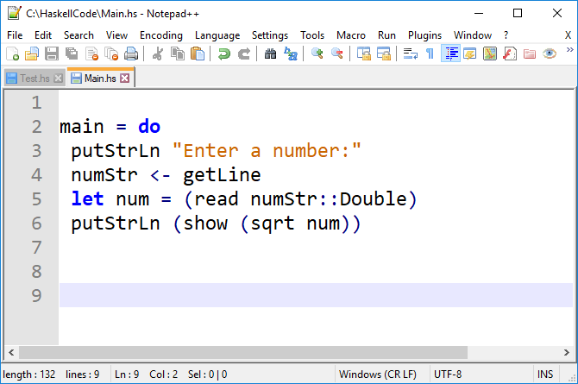
Actions & Functions
Use <- when binding the result of executing an action
Use let and = when binding the result of an expression

Slide 31
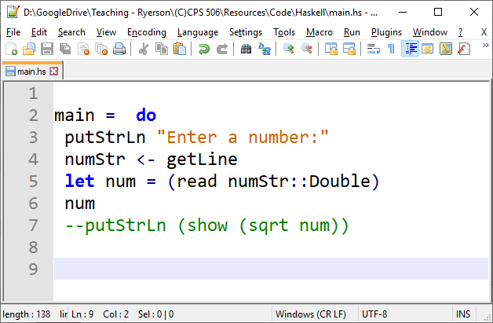
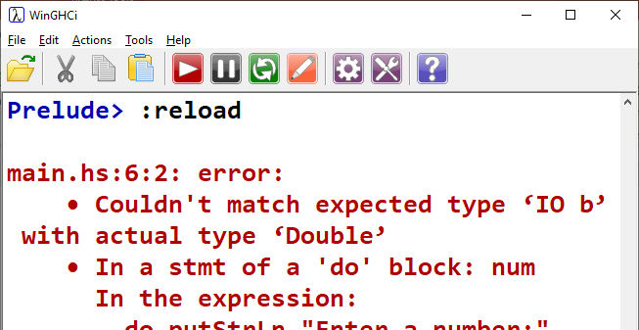
Problem?
main must be of type IO ()
The value of a “do” block is the value of the last expression evaluated

Slide 32
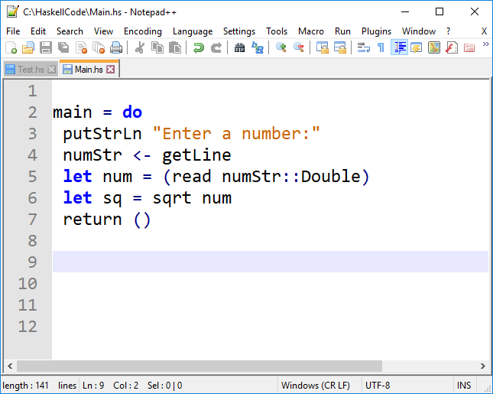
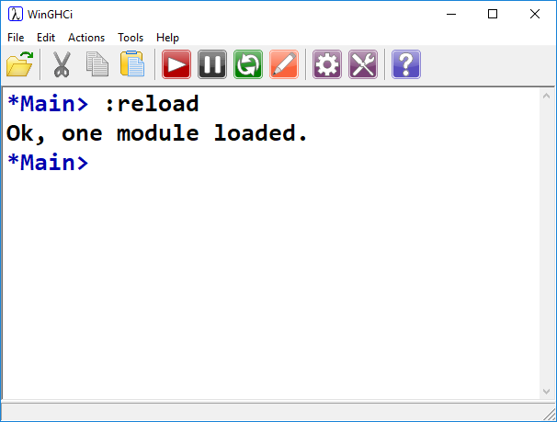
return ()
Return is NOT a keyword, it is a function.
It wraps data in a monad.
In this case, we’re wrapping an empty tuple ()
Who remembers the required return type of main?

Slide 33
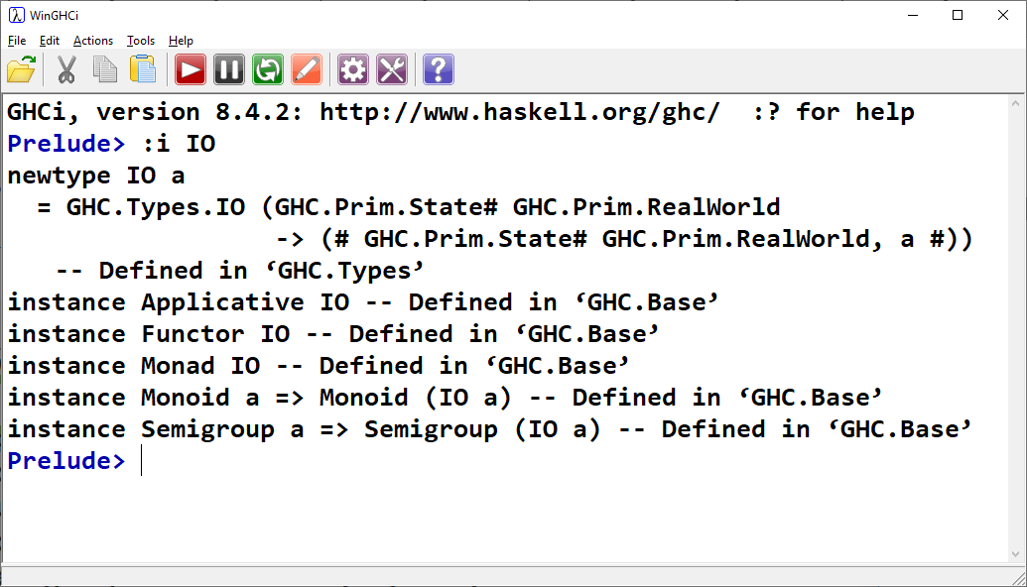

Slide 34
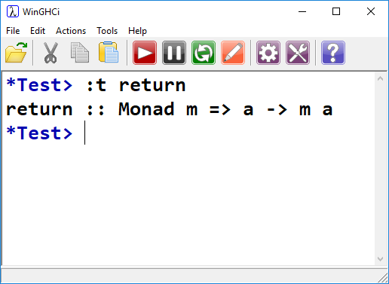
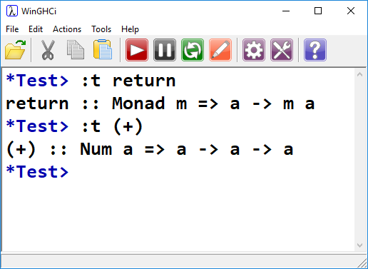
Monads
Here we get a clue about monads
Monad is actually a type class
This syntax resembles other type classes we’ve seen.

Slide 35
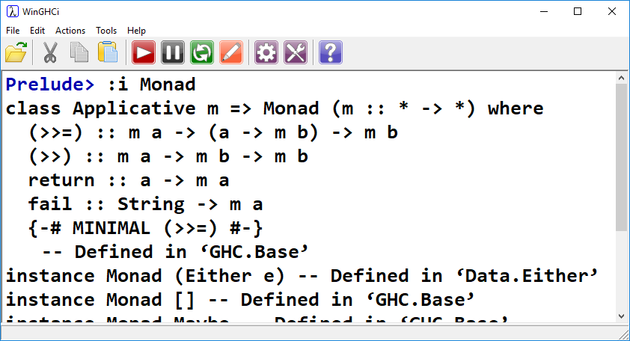
Monads
Monad is a typeclass:
We’ve seen these:
>>= passes the result on the left into the function on the right.
>> Ignores the result on the left
return wraps data in a monad

Slide 36
Monad Jargon
“Monadic”
Pertaining to monads. A monadic type is an instance of type class Monad (IO, for example)
“type xxx is a Monad”
xxx is an instance of type class Monad. xxx implements >>, >>=, and return
“action”
Another name for a monadic value
By the way:
It turns out that Monads are good for things other than side effect-producing IO.
We’ll see an example coming up.

Slide 37
>>= VS >>
Where the magic happens
>>=
Chains actions together. Result of left side is given as input to the right side.
>>
Chains actions together. Ignore result of left side.
a >> b = a >>= \_ -> b
>> can be defined in terms of >>=

Slide 38
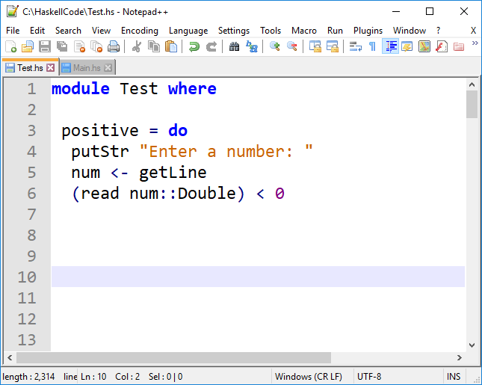
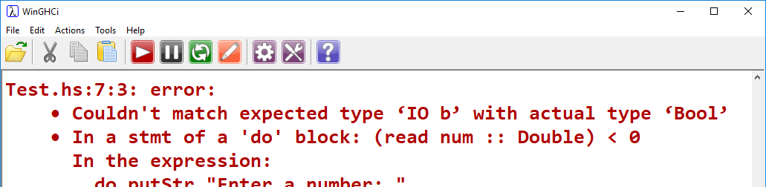
Non-main Example
Function that reads in a number and returns true if it’s less than zero, false otherwise.
Problem: We’re doing IO, thus the return type cannot be Boolean.
It must be IO something

Slide 39
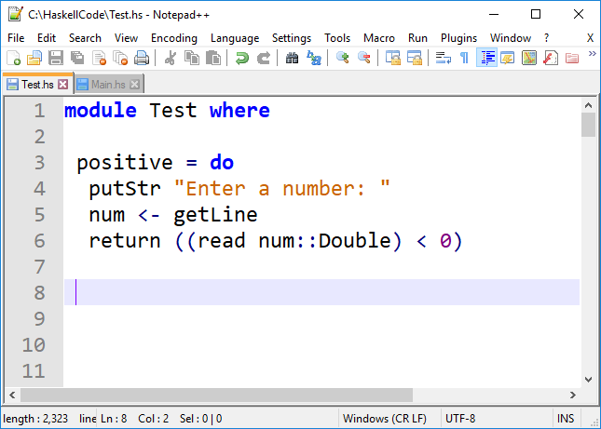
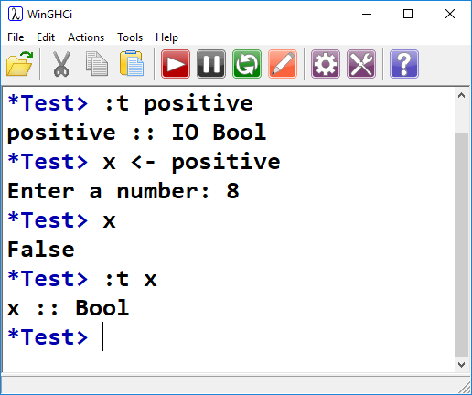
Non-main Example
What if we still want to get a Boolean back?
We extract the value from the action using <-
The return type of positive is an IO action.
That action, when executed, returns a Bool

Slide 40
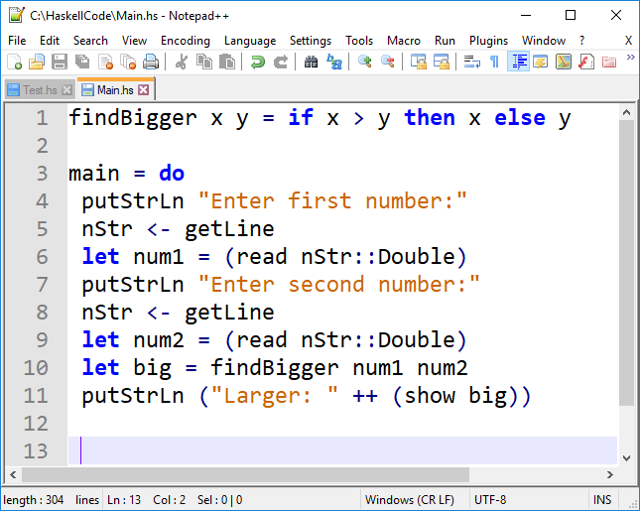
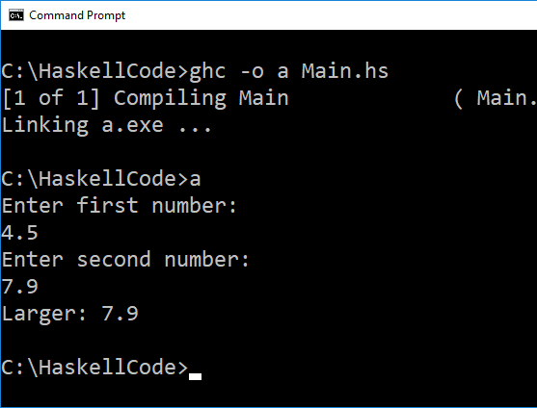
Calling Pure Code
We can still call pure functions from actions:

Slide 41
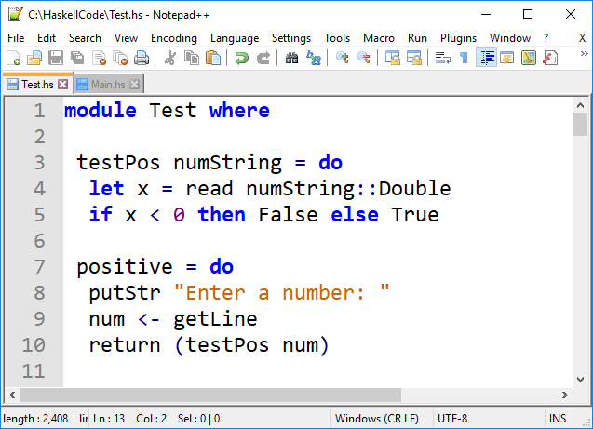
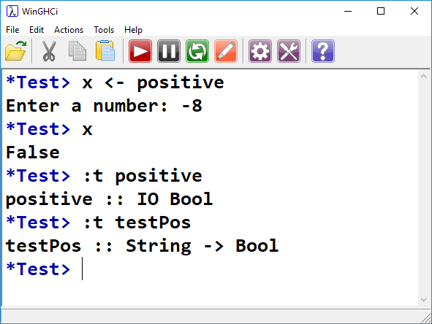
Best Practice
Separate pure code into its own functions:
Pure!
!Pure

Slide 42
When looking at main, Haskell looks rather imperative…
Even at this point, however, Haskell sets itself apart from imperative languages.
It creates a separate type of programming construct for operations that produce side effects
We can always be sure of which parts of the code will alter the state of the world, and which parts won’t.
Imperative languages do no such thing, and make no guarantees whatsoever regarding function purity

Slide 43
https://wiki.haskell.org/Introduction_to_Haskell_IO/Actions

Slide 44
https://wiki.haskell.org/Monad
“The essence of monad is thus separation of composition timeline from the composed computation's execution timeline, as well as the ability of computation to implicitly carry extra data”
“This lends monads to supplementing pure calculations with features like I/O, common environment, updatable state, etc.”
Not just for I/O! Not just for side effects!

Slide 45
Maybe Monad
Monads were originally introduced for IO operations
It turns out, as a construct, they are useful for modelling other things as well!
For example: exception handling, non-determinism, etc.

Slide 46
Maybe Monad
Represents a computation that might not produce a result
Computations that might “go wrong”
For example – calling tail with a list that might be empty
We can use Maybe to create a safety wrapper for functions that might fail, depending on input.

Slide 47
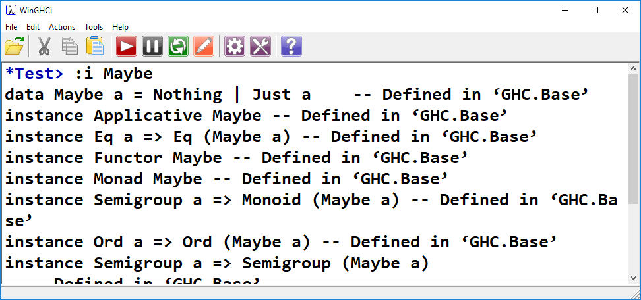
Maybe Monad
Maybe:
Custom data type
Instance of Monad
Maybe a can be Nothing, or Just a

Slide 48
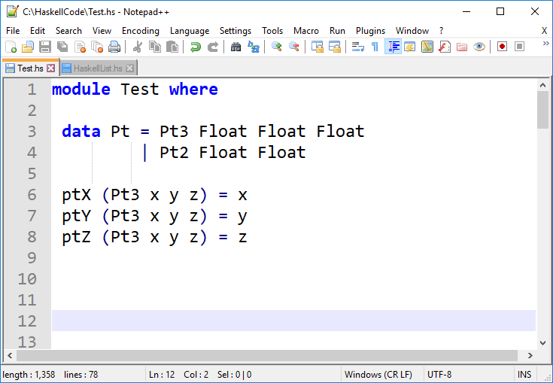
We’ve seen this before…
Pt can take the value Pt3 Float Float Float, or Pt2 Float Float
Maybe can take the value Nothing or Just a

Slide 49
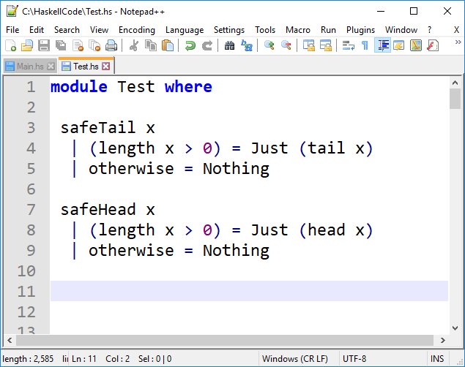
Maybe Monad
Define safe functions for head and tail.
Using guards - |
Instead of failing on empty lists, evaluate to Nothing.
If a tail or head can be found, evaluate to Just head x, or Just tail x
Just head? Just tail?

Slide 50
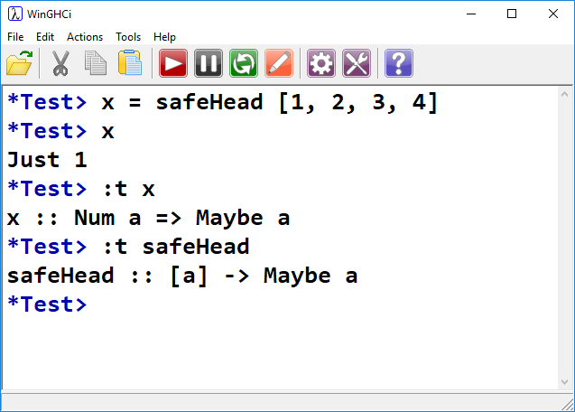
Maybe Monad
When we call safeHead on a non-empty list, we don’t get the head.
We get Just head
This is the head of the list wrapped in a Maybe monad.
Remember that Maybe is a type, just like our custom Pt type

Slide 51
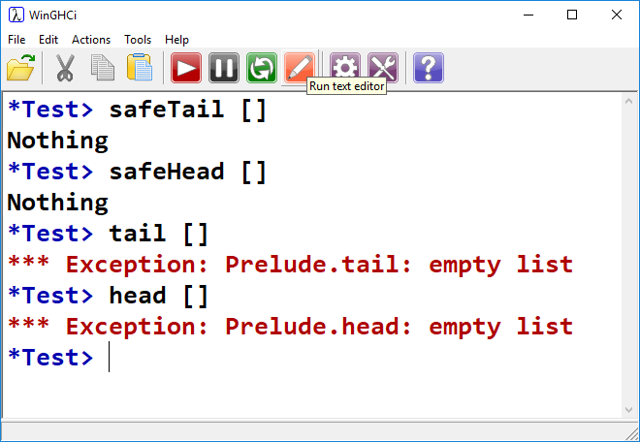
Maybe Monad

Slide 52
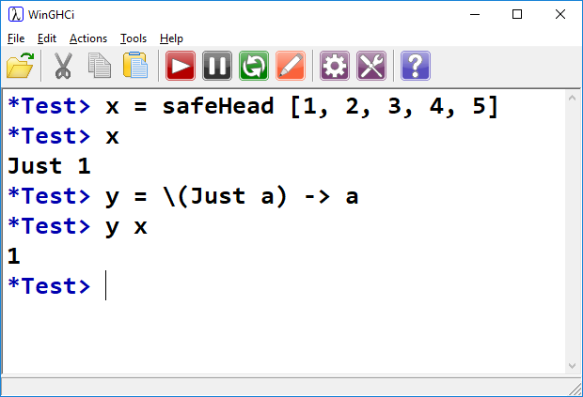
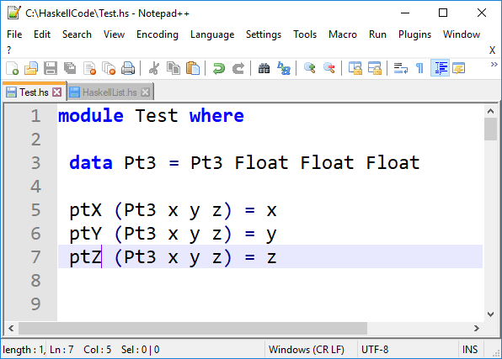
Unwrap Just a?
Just like pulling values out of our Pt data type!

Slide 53
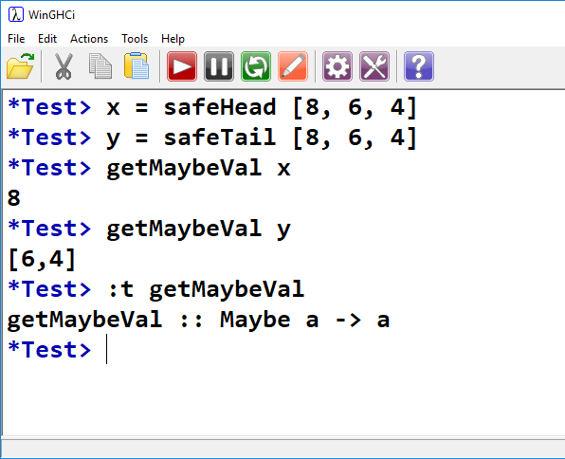
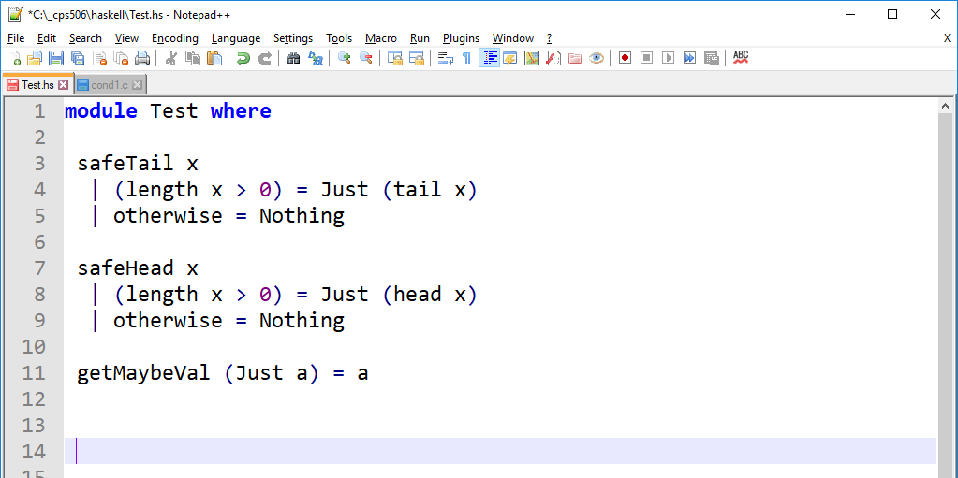

Slide 54
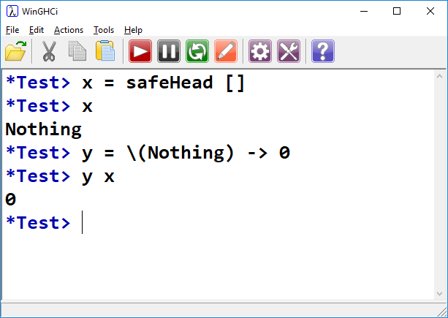
Unwrap Nothing?
If you need to decide on some numeric literal for Nothing, you can do so

Slide 55

Why Not This?
safeHead x
| (length x > 0) = head x
| otherwise = 0
Zero as error code
What if head of list is actually 0?
Static typing means list passed to safeHead can only be instance of Num!
Just can contain anything
Nothing is useful as an “error” value

Slide 56
Using Maybe
Maybe can make code safer by gracefully dealing with failure.
Should we use Maybe for everything?
No. Not everything has a chance to fail. Wrapping the return type of (x > y) in Maybe only serves to obfuscate your code.

Slide 57
Consider a Lookup Table
We have a list of tuple pairs:
book = [ (“Alex”, 555),
(“John”, 444),
(“Tim”, 333),
(“Mark”, 222),
(“Bill”, 111) ]
We want to search the table for a name
If found, return its number
If not found, return…. ?

Slide 58


Use lookup
It’s not obvious what we should return if an item is not found.
We might return -1, or null, but what if these are legitimate values that could be returned if a value was found?
In Haskell we can use Maybe for this.
It is preferable to an arbitrary default value, or an exception.

Slide 59

Just 555 VS 555
We would like to extract the numeric value 555
Can’t do arithmetic on Just 555, for example.

Slide 60


Just 555 VS 555
If we have a Just value, we can see its contents and extract through pattern matching

Slide 61

Use lookup
Value from book1 is the key to book2
Value of book2 is the key to book3
We want the value from book3
Not every value in book1 corresponds to a key in book2.
Not every value in book2 corresponds to a key in book3
There are several ways a lookup could fail

Slide 62









What happens if lookup fails to find a match?
We saw that it returns Nothing
What happens if we try to lookup Nothing?

Slide 63


Cascading Failure
Is the same as:

Slide 64
Cascading Failure
When the first argument to >>= is Nothing, it just returns Nothing while ignoring the given function
This causes failure to cascade
If the first lookup fails, Nothing is passed into the second >>=.
The failure then cascades into the third >>=, and is returned.
After the first Nothing, all subsequent >>= just pass that Nothing to each other
Nothing

Slide 65
Haskell Tutorials/References:
https://en.wikibooks.org/wiki/Yet_Another_Haskell_Tutorial
http://cheatsheet.codeslower.com/CheatSheet.pdf

Slide 66
Moving on…
…to imperative.
Rust is an imperative language. However, we’ll see many cool features that remind us of the functional languages we’ve seen.

Slide 67


